Slide 1
UNIT-V
DYNAMIC MEMORY ALLOCATION ,LINKED LIST AND FILES

Slide 2
CONTENTS
Dynamic Memory Allocation:
Memory allocation process
Allocating a block of memory
Releasing the used space

Slide 3
Problem with Arrays
Sometimes
Amount of data cannot be predicted beforehand
Number of data items keeps changing during program execution
Example: Search for an element in an array of N elements
One solution: find the maximum possible value of N and allocate an array of N elements
Wasteful of memory space, as N may be much smaller in some executions
Example: maximum value of N may be 10,000, but a particular run may need to search only among 100 elements
Using array of size 10,000 always wastes memory in most cases

Slide 4
Better Solution
Dynamic memory allocation
Know how much memory is needed after the program is run
Example: ask the user to enter from keyboard
Dynamically allocate only the amount of memory needed
C provides functions to dynamically allocate memory
malloc, calloc, realloc,free()

Slide 5
Memory Allocation Functions
malloc
Allocates requested number of bytes and returns a pointer to the first byte of the allocated space
calloc
Allocates space for an array of elements, initializes them to zero and then returns a pointer to the memory.
free
Frees previously allocated space.
realloc
Modifies the size of previously allocated space.

Slide 6
Memory Allocation Process
One of the region in memory is named heap. Size of heap keeps changing when the program is executed.
This happens as during the course of program execution few variables are created and few variables are destroyed when the block they were present is exited.

Slide 7
Allocating a Block of Memory
malloc() is present in <stdlib.h>
A block of memory can be allocated using the function malloc
Reserves a block of memory of specified size and returns a pointer of type void
The return pointer can be type-casted to any pointer type
General format:
type *p;
p = (type *) malloc (byte_size);

Slide 8
Example
p = (int *) malloc(100 * sizeof(int));
A memory space equivalent to 100 times the size of an int bytes is reserved
The address of the first byte of the allocated memory is assigned to the pointer p of type int
p
400 bytes of space

Slide 9
Contd.
cptr = (char *) malloc (20);
Allocates 20 bytes of space for the pointer cptr of type char
sptr = (struct stud *) malloc(10*sizeof(struct stud));
Allocates space for a structure array of 10 elements. sptr points to a structure element of type struct stud
Always use sizeof operator to find number of bytes for a data type, as it can vary from machine to machine

Slide 10
Points to Note
malloc always allocates a block of contiguous bytes
The allocation can fail if sufficient contiguous memory space is not available
If it fails, malloc returns NULL
if ((p = (int *) malloc(100 * sizeof(int))) == NULL)
{
printf (“\n Memory cannot be allocated”);
exit();
}

Slide 11
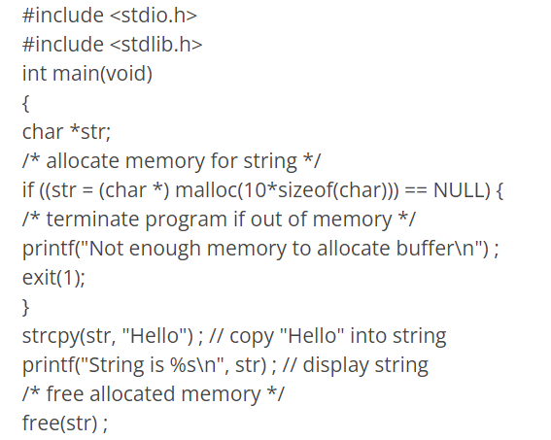
Allocate a 10 char string using malloc()

Slide 12
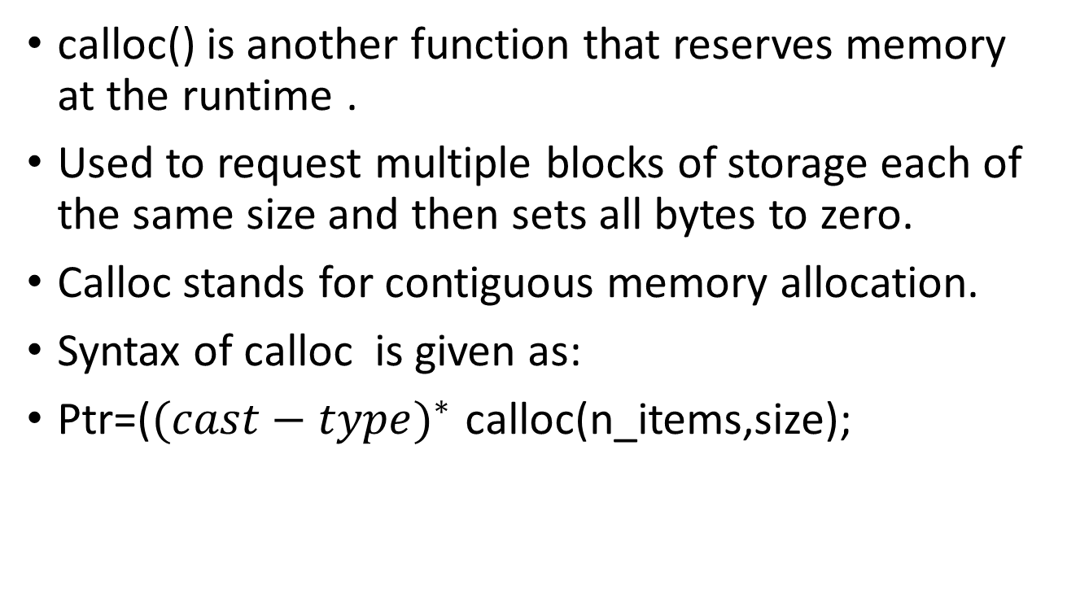
calloc
calloc() is another function that reserves memory at the runtime .
Used to request multiple blocks of storage each of the same size and then sets all bytes to zero.
Calloc stands for contiguous memory allocation.
Syntax of calloc is given as:
Ptr=(${(cast−type)}^{∗}$ calloc(n_items,size);

Slide 13
calloc
If calloc() could find space for array of n_items*size bytes of memory in the heap, then it returns a pointer to the block in memory.
If malloc() could not find space for n_items*size bytes of memory in the heap, then it returns a NULL.
always check for this condition when allocating memory.

Slide 14
Calloc code to check error in memory allocation
int *i_ptr ;
/* allocate memory for 20 integers*/
i_ptr = (int *)calloc(20, sizeof(int) ) ;
if (i_ptr == NULL)
{
printf("Not enough memory to allocate integers\n");
exit(-1);
/* terminate program if out of memory */}

Slide 15
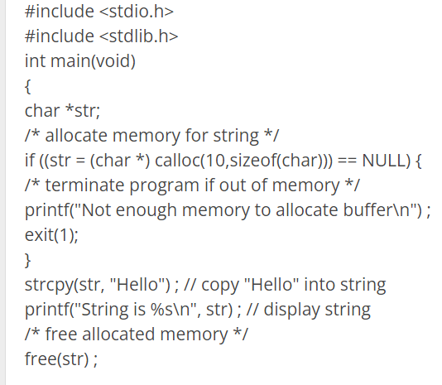
Allocate a 10 char string using calloc()

Slide 16
Releasing the used space
When a variable is allocated space during the compile time, then the memory used by that variable is automatically released by the system in accordance with its storage classes.
But when memory is allocated dynamically programmer has to release the space when it is not required.
free() deallocates the memory block created by a previous call to malloc() or calloc().
This frees up the memory so that it can be dynamically allocated again if required.

Slide 17
Releasing the used space
free() can only be used with the malloc() or calloc(). The size of the memory block is not required because the heap memory manager knows the size of the memory block from the address given. When the memory is allocated the heap memory manager remembers the address and the size.
Syntax of free is given below:
free(ptr);

Slide 18
Linked list and files

Slide 19
CONTENTS
Introduction
Linked lists vs Arrays
Memory allocation and Deallocation for a linked list
Types of linked lists
Singly linked lists
Introduction to files
Using files in C
Reading data from files
Writing data to files

Slide 20
CONTENTS
Detecting End-Of-File
Functions for selecting a record randomly
Remove()

Slide 21
Introduction
A linked list is a linear collection of data elements. These data elements are called nodes.
Linked lists are data structures which can be used to implement other data structures.
They are building blocks for other data structure like queue, stacks.
A linked list can be perceived as a train or a sequence of nodes in which each node contains one or more data fields and a pointer to the next node.

Slide 22
Introduction
A linked list is a data structure which can change during execution.
Successive elements are connected by pointers.
Last element points to NULL.
It can grow or shrink in size during execution of a program.
It can be made just as long as required.
It does not waste memory space.
head
A
B
C

Slide 23
Introduction
A linked list is implemented using the following code:
struct node
{
int data;
struct node *next;
};

Slide 24
Introduction
Left part of the node which contains data may include a simple data type, an array or a structure.
Right part of the node contains a pointer to the next node.
The last node will have no next node connected to it, so it will store a value called NULL.

Slide 25
Introduction
Keeping track of a linked list:
Must know the pointer to the first element of the list (called start, head, etc.).
Linked lists provide flexibility in allowing the items to be rearranged efficiently.
Insert an element.
Delete an element.

Slide 26
Array versus Linked Lists
Arrays are suitable for:
Inserting/deleting an element at the end.
Randomly accessing any element.
Searching the list for a particular value.
Linked lists are suitable for:
Inserting an element.
Deleting an element.
Applications where sequential access is required.
In situations where the number of elements cannot be predicted beforehand.

Slide 27
Disadvantages of Linked Lists:
Random access is not allowed. We have to access elements sequentially starting from the first node. So we cannot do a binary search with linked lists.
Extra memory space for a pointer is required for each element of the list.
Arrays have a better cache locality that can make a pretty big difference in performance.
It takes a lot of time in traversing and changing the pointers.
It will be confusing when we work with pointers.

Slide 28
Advantages of Arrays:
Arrays store multiple data of similar types with the same name.
It allows random access to elements.
As the array is of fixed size and stored in contiguous memory locations there is no memory shortage or overflow.
It is helpful to store any type of data with a fixed size.
Since the elements in the array are stored at contiguous memory locations it is easy to iterate in this data structure and unit time is required to access an element if the index is known.

Slide 29
Advantages of Arrays:
The size of the arrays is fixed: So we must know the upper limit on the number of elements in advance. Also, generally, the allocated memory is equal to the upper limit irrespective of usage, and in practical uses, the upper limit is rarely reached.
Inserting a new element in an array of elements is expensive because a room has to be created for the new elements and to create a room existing elements have to be shifted.

Slide 30
Disadvantages of Arrays:
The array is static in nature. Once the size of the array is declared then we can’t modify it.
Insertion and deletion operations are difficult in an array as elements are stored in contiguous memory locations and the shifting operations are costly.
The number of elements that have to be stored in an array should be known in advance.
Wastage of memory is the main problem in the array. If the array size is big the less allocation of memory leads to wastage of memory.

Slide 31
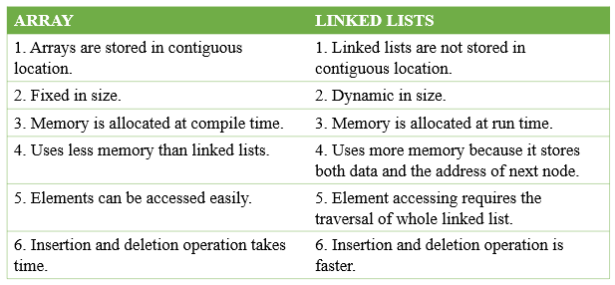
Arrays Vs Linked Lists

Slide 32
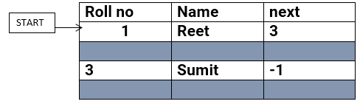
Memory allocation and Deallocation for a linked list
Linked list in memory is represented in tabular form where there are two main pointers:
START pointer refers to the first location of linked list as shown below:

Slide 33
Memory allocation and Deallocation for a linked list
The above figure shows that nodes need not to be stored in sequence and using the next pointer, we can refer to next node of linked list.
-1 represents the end of linked list that means this linked list holds two nodes.
The highlighted empty rows represents the available memory locations.
Now suppose if we want to add another node to current linked list then AVAIL pointer comes into picture.

Slide 34
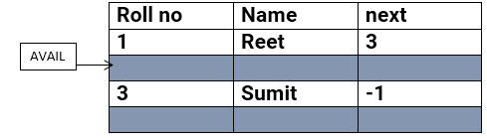
Memory allocation and Deallocation for a linked list
AVAIL pointer: The computer maintains a list of free available memory cells and this free space is called the free pool. AVAIL pointer stores the address of first free space in memory cells.

Slide 35
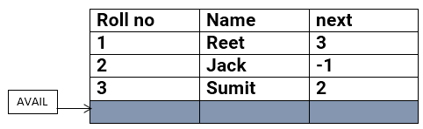
Memory allocation and Deallocation for a linked list
For adding new node in linked, computer checks if there is free memory cell exists. If there are multiple cells free then computer checks the address of memory that AVAIL pointer holds. Now, new node is added to memory which was pointed by AVAIL previously.

Slide 36
Memory allocation and Deallocation for a linked list
The above figure shows a new entry in linked list wherein AVAIL pointer holds the address of new free memory cell. This is how memory is allocated for linked lists.
Now, if we want to delete a node from linked list then that free space occupied by node must be given back to free pool so that memory can be reused by other programs that need memory space.

Slide 37
Memory allocation and Deallocation for a linked list
The operating system does this task of adding the freed memory to the free pool. The operating system will perform this operation whenever it finds the CPU idle or whenever the programs are falling short of memory space.
The operating system scans through all the memory cells and marks those cells that are being used by some program. Then it collects all the cells which are not being used and adds their address to the free pool, so that these cells can be reused by other programs. This process is called garbage collection.

Slide 38
Linked Lists and its types
A linked list is like a train where each bogie is connected with links. Different types of linked lists exist to make lives easier, like an image viewer, music player, or when you navigate through web pages.
Types of linked list
Singly linked lists
Doubly linked lists
Circular linked lists
Circular doubly linked lists

Slide 39
Introduction
A linked list is a data structure which can change during execution.
Successive elements are connected by pointers.
Last element points to NULL.
It can grow or shrink in size during execution of a program.
It can be made just as long as required.
It does not waste memory space.
head
A
B
C

Slide 40
Keeping track of a linked list:
Must know the pointer to the first element of the list (called start, head, etc.).
Linked lists provide flexibility in allowing the items to be rearranged efficiently.
Insert an element.
Delete an element.

Slide 41
Illustration: Insertion
A
B
C
tmp
X
Item to be inserted
A
A
B
C
curr
X

Slide 42
Pseudo-code for insertion
typedef struct nd {
struct item data;
struct nd * next;
} node;
void insert(node *curr)
{
node * tmp;
tmp=(node *) malloc(sizeof(node));
tmp->next=curr->next;
curr->next=tmp;
}

Slide 43
Illustration: Deletion
Item to be deleted
A
B
C
tmp
curr
A
B
C

Slide 44
Pseudo-code for deletion
typedef struct nd {
struct item data;
struct nd * next;
} node;
void delete(node *curr)
{
node * tmp;
tmp=curr->next;
curr->next=tmp->next;
free(tmp);
}

Slide 45
In essence ...
For insertion:
A record is created holding the new item.
The next pointer of the new record is set to link it to the item which is to follow it in the list.
The next pointer of the item which is to precede it must be modified to point to the new item.
For deletion:
The next pointer of the item immediately preceding the one to be deleted is altered, and made to point to the item following the deleted item.

Slide 46
Types of Lists
Depending on the way in which the links are used to maintain adjacency, several different types of linked lists are possible.
Linear singly-linked list (or simply linear list)
One we have discussed so far.
head
A
B
C

Slide 47
Circular linked list
The pointer from the last element in the list points back to the first element.
head
A
B
C

Slide 48
Doubly linked list
Pointers exist between adjacent nodes in both directions.
The list can be traversed either forward or backward.
Usually two pointers are maintained to keep track of the list, head and tail.
head
tail
A
B
C

Slide 49
Basic Operations on a List
Creating a list
Traversing the list
Inserting an item in the list
Deleting an item from the list
Concatenating two lists into one

Slide 50
Conceptual Idea
List
implementation
and the
related functions
Insert
Delete
Traverse

Slide 51
Example: Working with linked list
Consider the structure of a node as follows:
struct stud {
int roll;
char name[25];
int age;
struct stud *next;
};
/* A user-defined data type called “node” */
typedef struct stud node;
node *head;

Slide 52
Creating a List

Slide 53
How to begin?
To start with, we have to create a node (the first node), and make head point to it.
head = (node *) malloc(sizeof(node));
head
roll
name
next
age

Slide 54
Contd.
If there are n number of nodes in the initial linked list:
Allocate n records, one by one.
Read in the fields of the records.
Modify the links of the records so that the chain is formed.
head
A
B
C

Slide 55
node *create_list()
{
int k, n;
node *p, *head;
printf ("\n How many elements to enter?");
scanf ("%d", &n);
for (k=0; k<n; k++)
{
if (k == 0) {
head = (node *) malloc(sizeof(node));
p = head;
}
else {
p->next = (node *) malloc(sizeof(node));
p = p->next;
}
scanf ("%d %s %d", &p->roll, p->name, &p->age);
}
p->next = NULL;
return (head);
}

Slide 56
To be called from main() function as:
node *head;
………
head = create_list();

Slide 57
Traversing the List

Slide 58
What is to be done?
Once the linked list has been constructed and head points to the first node of the list,
Follow the pointers.
Display the contents of the nodes as they are traversed.
Stop when the next pointer points to NULL.

Slide 59
void display (node *head)
{
int count = 1;
node *p;
p = head;
while (p != NULL)
{
printf ("\nNode %d: %d %s %d", count,
p->roll, p->name, p->age);
count++;
p = p->next;
}
printf ("\n");
}

Slide 60
To be called from main() function as:
node *head;
………
display (head);

Slide 61
Inserting a Node in a List

Slide 62
How to do?
The problem is to insert a node before a specified node.
Specified means some value is given for the node (called key).
In this example, we consider it to be roll.
Convention followed:
If the value of roll is given as negative, the node will be inserted at the end of the list.

Slide 63
Contd.
When a node is added at the beginning,
Only one next pointer needs to be modified.
head is made to point to the new node.
New node points to the previously first element.
When a node is added at the end,
Two next pointers need to be modified.
Last node now points to the new node.
New node points to NULL.
When a node is added in the middle,
Two next pointers need to be modified.
Previous node now points to the new node.
New node points to the next node.

Slide 64
To insert a node
void insert (node **head)
{
int k = 0, rno;
node *p, *q, *new;
new = (node *) malloc(sizeof(node));
printf ("\nData to be inserted: ");
scanf ("%d %s %d", &new->roll, new->name, &new->age);
printf ("\nInsert before roll (-ve for end):");
scanf ("%d", &rno);
p = *head;
if (p->roll == rno) /* At the beginning */
{
new->next = p;
*head = new;
}

Slide 65
else
{
while ((p != NULL) && (p->roll != rno))
{
q = p;
p = p->next;
}
if (p == NULL) /* At the end */
{
q->next = new;
new->next = NULL;
}
else if (p->roll == rno)
/* In the middle */
{
q->next = new;
new->next = p;
}
}
}
The pointers
q and p
always point
to consecutive
nodes.

Slide 66
To be called from main() function as:
node *head;
………
insert (&head);

Slide 67
Deleting a node from the list

Slide 68
What is to be done?
Here also we are required to delete a specified node.
Say, the node whose roll field is given.
Here also three conditions arise:
Deleting the first node.
Deleting the last node.
Deleting an intermediate node.

Slide 69
void delete (node **head)
{
int rno;
node *p, *q;
printf ("\nDelete for roll :");
scanf ("%d", &rno);
p = *head;
if (p->roll == rno)
/* Delete the first element */
{
*head = p->next;
free (p);
}

Slide 70
else
{
while ((p != NULL) && (p->roll != rno))
{
q = p;
p = p->next;
}
if (p == NULL) /* Element not found */
printf ("\nNo match :: deletion failed");
else if (p->roll == rno)
/* Delete any other element */
{
q->next = p->next;
free (p);
}
}
}

Slide 71
Few Exercises to Try Out
Write a function to:
Concatenate two given list into one big list.
node *concatenate (node *head1, node *head2);
Insert an element in a linked list in sorted order. The function will be called for every element to be inserted.
void insert_sorted (node **head, node *element);
Always insert elements at one end, and delete elements from the other end (first-in first-out QUEUE).
void insert_q (node **head, node *element)
node *delete_q (node **head) /* Return the deleted node */

Slide 72
Files in C

Slide 73
Files in C
Introduction to files
Using files in C
Reading data from files
Writing data to files
Detecting End-Of-File
Functions for selecting a record randomly
Remove()

Slide 74
Introduction to files
Files are places where data can be stored permanently.
Some programs expect the same set of data to be fed as input every time it is run.
Cumbersome.
Better if the data are kept in a file, and the program reads from the file.
Programs generating large volumes of output.
Difficult to view on the screen.
Better to store them in a file for later viewing/ processing

Slide 75
Introduction …
Data files
When you use a file to store data for use by a program, that file usually consists of text (alphanumeric data) and is therefore called a text file.
Can be created, updated, and processed by C programs
Are used for permanent storage of large amounts of data
Storage of data in variables and arrays is only temporary

Slide 76
Files and Streams
C views each file as a sequence of bytes
File ends with the end-of-file marker
Stream created when a file is opened
Provide communication channel between files and programs
Opening a file returns a pointer to a FILE structure

Slide 77
Streams in C
The type of the C data structure that represents a stream is called FILE rather than “stream”. The FILE type is declared in the header file stdio.h.
Data Type: FILE This is the data type used to represent stream objects. A FILE object holds all of the internal state information about the connection to the associated file, including such things as the file position indicator and buffering information. Each stream also has error and end-of-file status indicators that can be tested with the ferror and feof functions; see End-Of-File and Errors.
FILE objects are allocated and managed internally by the input/output library functions. Don’t try to create your own objects of type FILE; let the library do it. Your programs should deal only with pointers to these objects (that is, FILE * values) rather than the objects themselves.

Slide 78
Streams in C…
When the main function of your program is invoked, it already has three predefined streams open and available for use. These represent the “standard” input and output channels that have been established for the process.
These streams are declared in the header file stdio.h.
Variable: FILE * stdinThe standard input stream, which is the normal source of input for the program.
Variable: FILE * stdoutThe standard output stream, which is used for normal output from the program.
Variable: FILE * stderrThe standard error stream, which is used for error messages and diagnostics issued by the program.

Slide 79
Buffers associated with file stream
Characters that are written to a stream are normally accumulated and transmitted asynchronously to the file in a block, instead of appearing as soon as they are output by the application program. Similarly, streams often retrieve input from the host environment in blocks rather than on a character-by-character basis. This is called buffering.

Slide 80
Buffering Concepts
There are three different kinds of buffering strategies:
Characters written to or read from an unbuffered stream are transmitted individually to or from the file as soon as possible.
Characters written to a line buffered stream are transmitted to the file in blocks when a newline character is encountered.
Characters written to or read from a fully buffered stream are transmitted to or from the file in blocks of arbitrary size.

Slide 81
Types of files in C
C programming language supports two types of files and they are as follows...
Text Files (or) ASCII Files
Binary Files
Text File (or) ASCII File - The file that contains ASCII codes of data like digits, alphabets and symbols is called text file (or) ASCII file.
Binary File - The file that contains data in the form of bytes (0's and 1's) is called as binary file. Generally, the binary files are compiled version of text files.

Slide 82
Using files in C- file operations
Declare a file pointer variable in C
Opening a file
Reading data from a file
Writing data to a file
Closing a file

Slide 83
Declaring a file pointer variable
The syntax used for declaring a file pointer in C is as follows:
FILE *filePointer;
Here, FILE is a pre-defined structure in C that is used to handle file I/O operations.
The filePointer is a variable that will store the memory address of the file's current position.

Slide 84
Opening a file
A file must be “opened” before it can be used.
FILE *fp;
:
fp = fopen (filename, mode);
fp is declared as a pointer to the data type FILE.
filename is a string - specifies the name of the file.
fopen returns a pointer to the file which is used in all subsequent file operations.
mode is a string which specifies the purpose of opening the file:
“r” :: open the file for reading only
“w” :: open the file for writing only
“a” :: open the file for appending data to it

Slide 85
File Modes
r - open a file in read-mode, set the pointer to the beginning of the file.
w - open a file in write-mode, set the pointer to the beginning of the file.
a - open a file in write-mode, set the pointer to the end of the file.
rb - open a binary-file in read-mode, set the pointer to the beginning of the file.
wb - open a binary-file in write-mode, set the pointer to the beginning of the file.
ab - open a binary-file in write-mode, set the pointer to the end of the file.
r+ - open a file in read/write-mode, if the file does not exist, it will not be created.
w+ - open a file in read/write-mode, set the pointer to the beginning of the file.
a+ - open a file in read/append mode.
r+b - open a binary-file in read/write-mode, if the file does not exist, it will not be created.
w+b - open a binary-file in read/write-mode, set the pointer to the beginning of the file.
a+b - open a binary-file in read/append mode.

Slide 86
Contd..
Points to note:
Several files may be opened at the same time.
For the “w” and “a” modes, if the named file does not exist, it is automatically created.
For the “w” mode, if the named file exists, its contents will be overwritten.

Slide 87
Examples
FILE *in, *out ;
in = fopen (“mydata.dat”, “r”) ;
out = fopen (“result.dat”, “w”);
FILE *empl ;
char filename[25];
scanf (“%s”, filename);
empl = fopen (filename, “r”) ;

Slide 88
Closing a file
After all operations on a file have been completed, it must be closed.
Ensures that all file data stored in memory buffers are properly written to the file.
General format: fclose (file_pointer) ;
FILE *xyz ;
xyz = fopen (“test.txt”, “w”) ;
…….
fclose (xyz) ;

Slide 89
Contd..
fclose( FILE pointer )
Closes specified file
Performed automatically when program ends
Good practice to close files explicitly
system resources are freed.
Also, you might not find that all the information that you've written to the file has actually been written to disk until the file is closed.
feof( FILE pointer )
Returns true if end-of-file indicator (no more data to process) is set for the specified file

Slide 90
Read/Write functions in standard library
getc
Reads one character from a file
Takes a FILE pointer as an argument
fgetc( stdin ) equivalent to getchar()
putc
Writes one character to a file
Takes a FILE pointer and a character to write as an argument
fputc( 'a', stdout ) equivalent to putchar( 'a' )
scanf / fprintf
File processing equivalents of scanf and printf

Slide 91
Read/write functions in C
The simplest file input-output (I/O) function are getc and putc.
getc is used to read a character from a file and return it.
char ch; FILE *fp;
…..
ch = getc (fp) ;
getc will return an end-of-file marker EOF, when the end of the file has been reached.
putc is used to write a character to a file.
char ch; FILE *fp;
……
putc (ch, fp) ;

Slide 92
Example :: convert a text file to all UPPERCASE
main() {
FILE *in, *out ;
char c ;
in = fopen (“infile.dat”, “r”) ;
out = fopen (“outfile.dat”, “w”) ;
while ((c = getc (in)) != EOF)
putc (toupper (c), out);
fclose (in) ;
fclose (out) ;
}

Slide 93
Contd..
Can also use the file versions of scanf and printf, called fscanf and fprintf.
General format:
fscanf (file_pointer, control_string, list) ;
fprintf (file_pointer, control_string, list) ;
Examples:
fscanf (fp, “%d %s %f”, &roll, dept_code, &cgpa) ;
fprintf (out, “\nThe result is: %d”, xyz) ;

Slide 94
Writing data to file
C provides the following functions to write data to a file:
fprintf()
fputs()
fputc()
fwrite()
fprintf
Used to print to a file
It is like printf, except first argument is a FILE pointer (pointer to the file you want to print in)

Slide 95
How to check EOF condition when using fscanf?
Use the function feof
if (feof (fp))
printf (“\n Reached end of file”) ;
How to check successful open?
For opening in “r” mode, the file must exist.
if (fp == NULL)
printf (“\n Unable to open file”) ;

Slide 96
getc() and putc()
handle one character at a time like getchar() and putchar()
syntax: putc(c,fp1);
c : a character variable
fp1 : pointer to file opened with mode w
syntax: c = getc(fp2);
c : a character variable
fp2 : pointer to file opened with mode r
file pointer moves by one character position after every getc() and putc()
getc() returns end-of-file marker EOF when file end reached

Slide 97
Program to read/write using getc/putc
#include <stdio.h>
main()
{ FILE *fp1;
char c;
f1= fopen(“INPUT”, “w”); /* open file for writing */
while((c=getchar()) != EOF) /*get char from keyboard until CTL-Z*/
putc(c,f1); /*write a character to INPUT */
fclose(f1); /* close INPUT */
f1=fopen(“INPUT”, “r”); /* reopen file */
while((c=getc(f1))!=EOF) /*read character from file INPUT*/
printf(“%c”, c); /* print character to screen */
fclose(f1);
} /*end main */

Slide 98
fscanf() and fprintf()
similar to scanf() and printf()
in addition provide file-pointer
given the following
file-pointer f1 (points to file opened in write mode)
file-pointer f2 (points to file opened in read mode)
integer variable i
float variable f
Example:
fprintf(f1, “%d %f\n”, i, f);
fprintf(stdout, “%f \n”, f); /*note: stdout refers to screen */
fscanf(f2, “%d %f”, &i, &f);
fscanf returns EOF when end-of-file reached

Slide 99
getw() and putw()
handle one integer at a time
syntax: putw(i,fp1);
i : an integer variable
fp1 : pointer to file ipened with mode w
syntax: i = getw(fp2);
i : an integer variable
fp2 : pointer to file opened with mode r
file pointer moves by one integer position, data stored in binary format native to local system
getw() returns end-of-file marker EOF when file end reached

Slide 100
C program using getw, putw,fscanf, fprintf
#include <stdio.h>
main()
{ int i,sum1=0;
FILE *f1;
/* open files */
f1 = fopen("int_data.bin","w");
/* write integers to files in binary and text format*/
for(i=10;i<15;i++) putw(i,f1);
fclose(f1);
f1 = fopen("int_data.bin","r");
while((i=getw(f1))!=EOF)
{ sum1+=i;
printf("binary file: i=%d\n",i);
} /* end while getw */
printf("binary sum=%d,sum1);
fclose(f1);
}
#include <stdio.h>
main()
{ int i, sum2=0;
FILE *f2;
/* open files */
f2 = fopen("int_data.txt","w");
/* write integers to files in binary and text format*/
for(i=10;i<15;i++) printf(f2,"%d\n",i);
fclose(f2);
f2 = fopen("int_data.txt","r");
while(fscanf(f2,"%d",&i)!=EOF)
{ sum2+=i; printf("text file: i=%d\n",i);
} /*end while fscanf*/
printf("text sum=%d\n",sum2);
fclose(f2);
}

Slide 101
On execution of previous Programs
$ ./a.out
binary file: i=10
binary file: i=11
binary file: i=12
binary file: i=13
binary file: i=14
binary sum=60,
$ cat int_data.txt
10
11
12
13
14
$ ./a.out
text file: i=10
text file: i=11
text file: i=12
text file: i=13
text file: i=14
text sum=60
$ more int_data.bin
^@^@^@^K^@^@^@^L^@^@^@^M^@^@^@^N^@^@^@
$

Slide 102
fread( ) and fwrite( )
size_t fread(void *buffer, size_t numbytes, size_t count, FILE *a_file);
size_t fwrite(void *buffer, size_t numbytes, size_t count, FILE *a_file);
Buffer in fread is a pointer to a region of memory that will receive the data from the file. Buffer in fwrite() is a pointer to the information that will be written to the file.
The second argument is the size of the element; it is in bytes. For example, if you have an array of characters, you would want to read it in one byte chunks, so numbytes is one. You can use the sizeof operator to get the size of the various datatypes; for example, if you have a variable, int x; you can get the size of x with sizeof(x);

Slide 103
Contd..
The third argument is simply how many elements you want to read or write; for example, if you pass a 100 element array
The final argument is simply the file pointer
Size_t is an unsigned integer.
fread() returns number of items read and fwrite() returns number of items written
To check to ensure the end of file was reached, use the feof function, which accepts a FILE pointer and returns true if the end of the file has been reached.

Slide 104
/* a simple example of using fread and fwrite to read and write an array of structures */
#include <stdio.h>
#include <conio.h>
int main()
{
FILE *fp;
struct prod {
int cat_num;
float cost;
};
typedef struct prod product;
product a[3] = {{2,20.1},{4,40.1},{6,60.1}};
product k, *p = &k;

Slide 105
fp = fopen("c:\fread1.txt","w+");
// write the entire array into the file pointed to by fp
fwrite(a, sizeof(product), 3, fp);
// prepare for reading from the beginning of the file
rewind(fp);
// read from the file one product at a time
for (i=0; i<3; i++) {
fread(p, sizeof(product), 1, fp);
printf(" product %d, cat_num=%d, cost=%f\n", i,p->cat_num,p->cost);
}
getch();
}

Slide 106
Example: Merge two files
#include <stdio.h>
int main()
{ FILE *fileA, /* first input file */
*fileB, /* second input file */
*fileC; /* output file to be created */
int num1, /* number to be read from first file */
num2; /* number to be read from second file */
int f1, f2;
/* Open files for processing */
fileA = fopen("class1.txt","r");
fileB = fopen("class2.txt","r");
fileC = fopen("class.txt","w");

Slide 107
/* As long as there are numbers in both files, read and compare numbers one by one. Write the smaller number to the output file and read the next number in the file from which the smaller number is read. */
f1 = fscanf(fileA, "%d", &num1); f2 = fscanf(fileB, "%d", &num2); while ((f1!=EOF) && (f2!=EOF)){ if (num1 < num2){ fprintf(fileC,"%d\n", num1); f1 = fscanf(fileA, "%d", &num1); } else if (num2 < num1) { fprintf(fileC,"%d\n", num2); f2 = fscanf(fileB, "%d", &num2); } else { /* numbs are equal:read from both files */ fprintf(fileC,"%d\n", num1); f1 = fscanf(fileA, "%d", &num1); f2 = fscanf(fileB, "%d", &num2); } }

Slide 108
while (f1!=EOF){/* if reached end of second file, read the remaining numbers from first file and write to output file */ fprintf(fileC,"%d\n", num1); f1 = fscanf(fileA, "%d", &num1); } while (f2!=EOF){ if reached the end of first file, read the remaining numbers from second file and write to output file */ fprintf(fileC,"%d\n", num2); f2 = fscanf(fileB, "%d", &num2); } /* close files */ fclose(fileA); fclose(fileB); fclose(fileC); return 0; } /* end of main */

Slide 109
Exercises
. Write a C language program to read “mark.dat” file containing rollno, name,marks of three subjects and calculate total mark, result in grade and store same in “result.dat” file. (Note : Make use of fread and fwrite functions)
2. Write a C language program to read a cust.dat file containing meter number, name, current reading & previous reading. Read the same file. Calculate unit and total amounts according to the following rules —
Unit rate
0-50 1.00
51-100 1.50
> 100 2.00
Store meter number ,name ,unit & amount in master.dat file.

Slide 110
Errors that occur during I/O
Typical errors that occur
trying to read beyond end-of-file
trying to use a file that has not been opened
perform operation on file not permitted by ‘fopen’ mode
open file with invalid filename
write to write-protected file

Slide 111
Error handling
given file-pointer, check if EOF reached, errors while handling file, problems opening file etc.
check if EOF reached: feof()
feof() takes file-pointer as input, returns nonzero if all data read and zero otherwise
if(feof(fp))
printf(“End of data\n”);
ferror() takes file-pointer as input, returns nonzero integer if error detected else returns zero
if(ferror(fp) !=0)
printf(“An error has occurred\n”);

Slide 112
Error while opening file
if file cannot be opened then fopen returns a NULL pointer
Good practice to check if pointer is NULL before proceeding
fp = fopen(“input.dat”, “r”);
if (fp == NULL)
printf(“File could not be opened \n ”);

Slide 113
Random accessing of files
Random accessing of files in C language can be done with the help of the following functions −
ftell ( )
rewind ( )
fseek ( )

Slide 114
ftell ( )
It returns the current position of the file ptr.
The syntax is as follows −
int n = ftell (file pointer)For example,
FILE *fp; int n;
_____ _____ _____
n = ftell (fp);Note − ftell ( ) is used for counting the number of characters which are entered into a file.

Slide 115
rewind ( )
It makes file ptr move to beginning of the file.
The syntax is as follows −
rewind (file pointer);For example,
FILE *fp; ----- ----- rewind (fp); n = ftell (fp); printf ("%d”, n);Output
The output is as follows −
0 (always).

Slide 116
fseek ( )
It is to make the file pointer point to a particular location in a file.
The syntax is as follows −
fseek(file pointer, offset, position);Offset
The no of positions to be moved while reading or writing.
If can be either negative (or) positive.
Positive - forward direction.
Negative – backward direction.
Position
It can have three values, which are as follows −
0 – Beginning of the file.
1 – Current position.
2 – End of the file.

Slide 117
Example
fseek (fp,0,2) - fp moved 0 bytes forward from the end of the file.
fseek (fp, 0, 0) – fp moved 0 bytes forward from beginning of the file
fseek (fp, m, 0) – fp moved m bytes forward from the beginning of the file.
fseek (fp, -m, 2) – fp moved m bytes backward from the end of the file.
Errors
The errors related to fseek () function are as follows −
fseek (fp, -m, 0);
fseek(fp, +m, 2);

Slide 118
Random access to files
how to jump to a given position (byte number) in a file without reading all the previous data?
fseek (file-pointer, offset, position);
position: 0 (beginning), 1 (current), 2 (end)
offset: number of locations to move from position
Example: fseek(fp,-m, 1); /* move back by m bytes from current position */
fseek(fp,m,0); /* move to (m+1)th byte in file */
fseek(fp, -10, 2); /* what is this? */
ftell(fp) returns current byte position in file
rewind(fp) resets position to start of file

Slide 119
Command line arguments
can give input to C program from command line
E.g. > prog.c 10 name1 name2 ….
how to use these arguments?
main ( int argc, char *argv[] )
argc – gives a count of number of arguments (including program name)
char *argv[] defines an array of pointers to character (or array of strings)
argv[0] – program name
argv[1] to argv[argc -1] give the other arguments as strings

Slide 120
Example args.c
#include <stdio.h>
main(int argc,char *argv[])
{
while(argc>0) /* print out all arguments in reverse order*/
{
printf("%s\n",argv[argc-1]);
argc--;
}
}
$ cc args.c -o args.out
$ ./args.out 2 join leave 6
6
leave
join
2
./args.out
$

